Slide 1
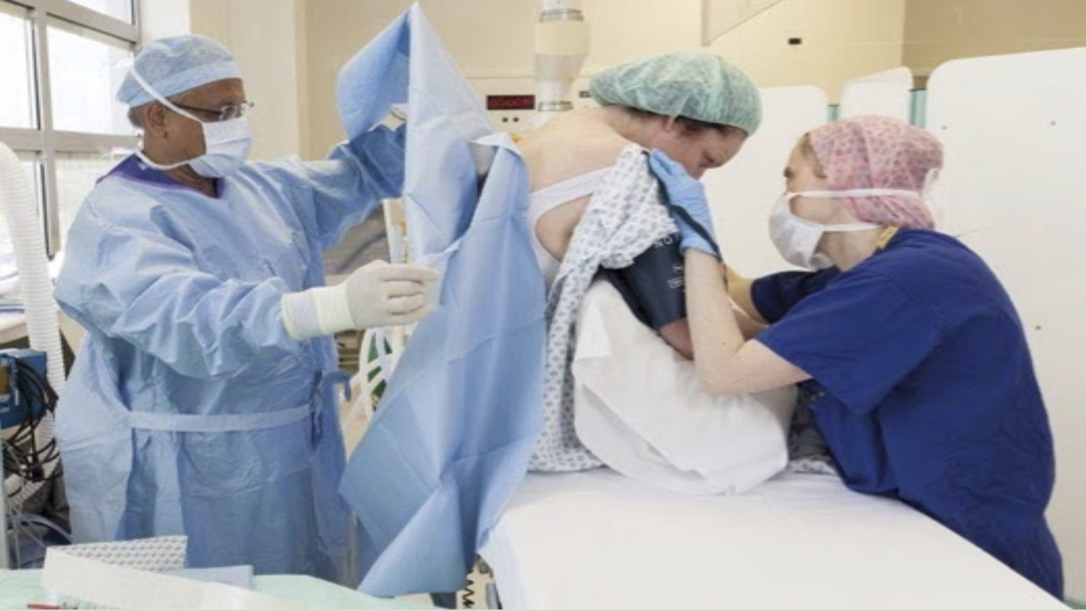
QI Project: Short acting spinal anesthesia improves patient & enhanced recovery outcomes, patient/staff satisfaction and same-day discharge rates in urological, gynaecological & non-delivery obstetrics and general surgical procedures
Janice Yiu¹, Maxine Okello², Thaamharah Mahendrayogam³
Medical Student, University College London¹, Clinical Fellow in Perioperative Medicine, University College London Hospitals NHS Foundation Trust², Consultant Anaesthetist, University College London Hospitals NHS Foundation Trust ³
Introduction
Results
Same day discharge rates
For prilocaine spinal cases (excludes delays due to medical/planned surgical reasons):
79% (13/17 Urology & 13/13 Gynae) vs. 71% GA (15/26 Urology & 14/14 Gynae)
Without escort: 7 patients (10%)
4 by taxi, 2 by hospital transport & 1 by bus
4 Urology, 1 Gynae, 1 Obstetrics & 1 General
3 had midazolam
** 12 patients (1 spinal vs. 11 GA) stayed overnight due to living alone. 3 spinals stayed in due to patient preferences.
Prilocaine spinal cases
Total: 76
45 Urology
16 Gynaecology
13 Obstetrics (cervical sutures)
2 General
GA cases
Total: 70
53 Urology
16 Gynaecology
1 General
Spinal block with prilocaine compared with general anaesthesia (GA) has been associated with better patient and hospital outcomes. These include less post-operative nausea and vomiting (PONV), less hypotension [1], and avoids aerosol generating procedures (such as GAs) which are all likely to improve same-day discharge rates [2].
PONV requiring anti-emetics
3 Spinal cases (Gynae): 4%
vs.
8 GA cases (Urology) : 11%
Hypotension requiring vasopressor use in 3 spinal cases (Urology): 4%
vs.
14 GA cases (9 Urology, 5 Gynae): 20%
26 Urology inpatient stays were due to requiring trial without catheter (TWOC), 49%
47% Urology patients asked would go home the SAME day with an indwelling urinary catheter.
50% Urology & Gynae patients asked would be happy to go home without an escort and be home alone overnight.
Methods
Table 1. Time into Recovery until ward ready time (Median & Interquartile range duration/ mins)
 | Urology | Gynae
Prilocaine spinal | 92 (58, 220) | 145 (74, 191) [Second stage recovery area often unavailable]
GA | 106 (96, 170) | 81 (64, 138)
Cervical sutures
13 Prilocaine cases vs. 13 Bupivacaine cases
Reduced length of stay by 2hr: 6mins
Increased same-day discharge rate (10 vs. 8)
We conducted a prospective study from June 2020 – April 2021 at University College London Hospitals NHS Foundation Trust. We assessed the effectiveness of prilocaine for a variety of day case procedures (compared with GA) on the incidence of PONV, hypotension, patient satisfaction and same-day discharge rates. In addition, we compared prilocaine against bupivacaine spinal anaesthesia for cervical sutures.
Conclusion
Compared with GA, prilocaine spinal anaesthesia is effective in:
Improvement in patient/staff satisfaction & patient outcomes.
Reduction of post-operative complications.
Reduction in recovery time and earlier eating & drinking (DREAming).
Avoidance of GA – thereby reducing the risk of COVID-19 transmission.
Provision of anaesthesia in patients with previous or long COVID-19.
Improvement of same-day discharge rates including the discharge of some patients without an escort.
Reduction of length of stay for cervical sutures (compared to bupivacaine).
We aim to review our trust’s discharge criteria, TWOC clinic capacity and second stage recovery area at all sites.
Overall patient satisfaction with prilocaine spinal block: 97%
(95% after spinal, 98% during operation, 96% after procedure)
Feedback:
Patient: “Amazing”, “Nice to talk to surgeon & team”
Staff: “Relaxed environment”, “Less equipment & drugs needed”
Acknowledgements:
Islam Uddin, Sahiba Sethi, Simeon West, Damon Kamming, John Dick, Melaine Tan, Gautam Kumar, Simon Clarke, Dave Walker, Kim Russon, Ben Fox and Robbie Erskine
Image credits: Background photograph from the Royal College of Anaesthetists (RCoA)
References: [1] Rattenberry W, Hertling A, & Erskine R. Spinal anaesthesia for ambulatory surgery. BJA Educ 2019;19:321–8.
[2] Royal College of Anaesthetists. Guidelines for the Provision of Anaesthetic Services Chapter 6: Guidelines for the Provision of Anaesthesia Services for Day Surgery 2021. London: RCoA; 2021.

